Slide 1
Indoors Introduction & Basics
Coach notes

Slide 2
PREFACE - These slides are not meant to teach the plays/structures, just go over the concepts and reiterate key points. To learn the plays/structures they need to be practiced at trainings.
Everything in here has been run by a variety of teams at differing levels for various levels of success and I’ve tried to include demonstrations of the plays/structures being run in competitive games. Rarely will the plays/structures work as clearly defined so being able to adapt to the situation is key.
Practice is key. A simple offence/defence can be very effective if everyone on the team is experienced at running it.

Slide 3
Offence

Slide 4
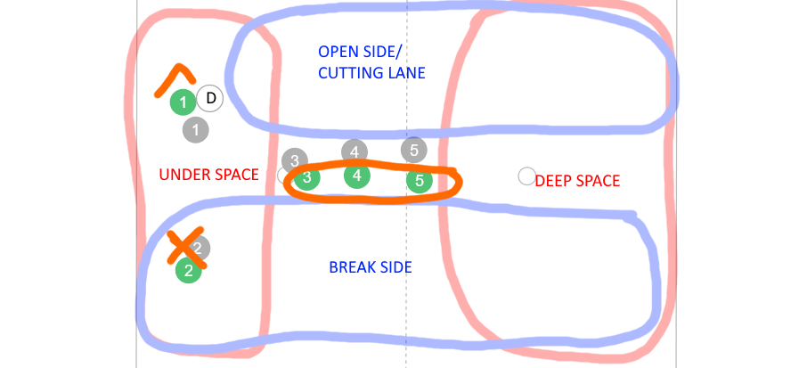
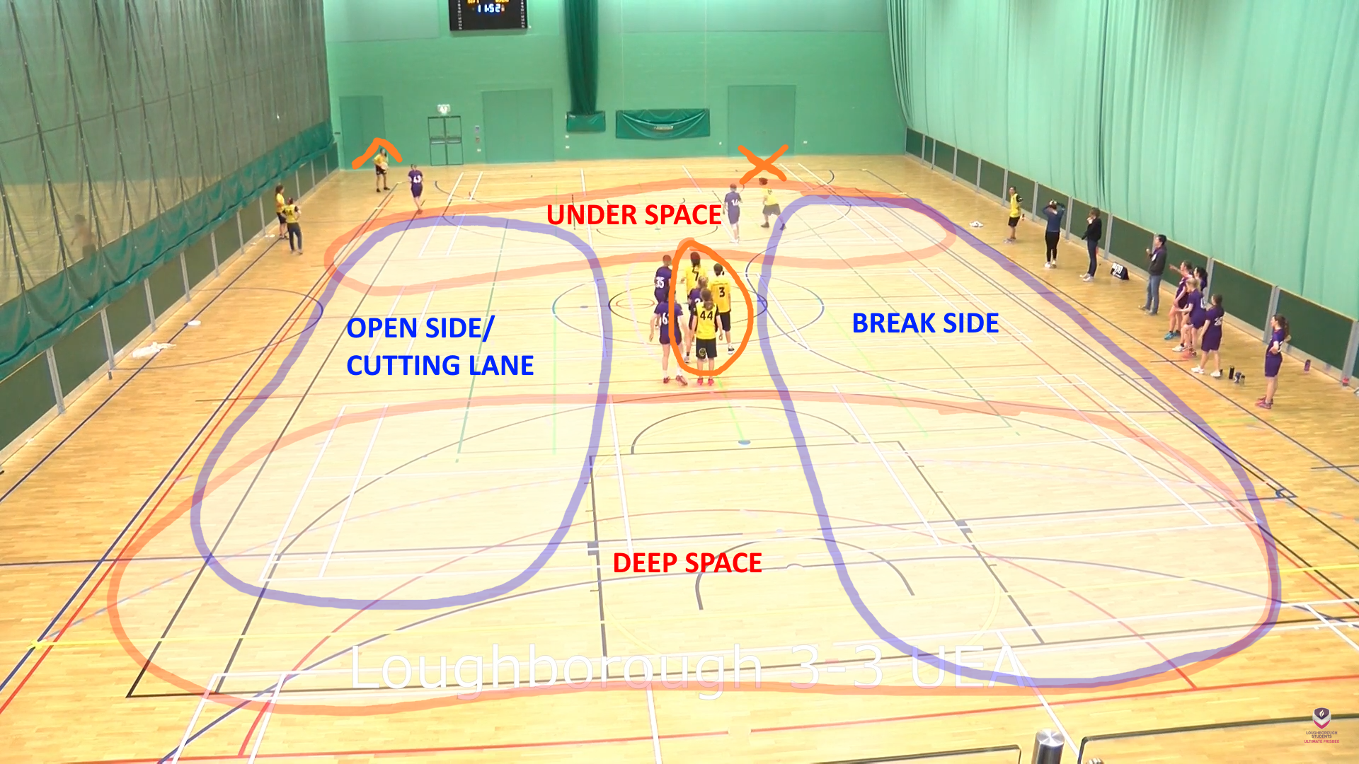
Basics
^ is the HANDLER
X is the RESET/dump/other handler
STACK is circled in 0
UP-LINE is going from the under space to the deep space on the open side
CLEAR OUT means to leave the cutting lane or under space into the stack or the deep space
Traditionally run you offence until ⅔ up the pitch and then get into and endzone set
Fast, confident cuts to get the disc, then clearing out into the stack/deep space
Look for a reset option on a high stall
Use overheads to the break side

Slide 5
Basics 2: slightly less basic
If you are ‘faked’ (handler fakes a throw whilst looking at you) it means they want you to cut somewhere and move! Often it’s because they want you to clear out of a space for someone else to be moving into.
When we cut deep we want to be cutting towards the corners of the endzone and then ‘bouncing’ (counter-cutting to the other side of the endzone) to give our thrower 2 clear options. This is also called a ‘7 cut’ as it looks like the number 7 from above.
When the other team is playing a ZONE DEFENCE then you normally CANNOT RUN YOUR PLANNED OFFENCE. The other team is trying to clog up your throwing lanes making cutting harder. Find some space, be an option for your handlers, call for the disc, back your throwers to make the right decisions and work the disc up patiently.
If you are Poached it means your defender has left you unmarked to help mark another player/position. If you are poached you should go and get the disc. You have no defender so it should be an easy throw and you will then force a defender to come and stall you. Freeing up space on the pitch.

Slide 6

Vert
Basic, starter offence
2 handlers, 3 cutters in a stack. Unless you are back in your own endzone, where 1 handler/4 cutters gives you more under space to work with.
Cut hard to get the disc, clear out just as hard.
Use deep options, don’t only cut under.
https://www.ultiplays.com/shares/Yeo4EXe4QMUmgdaRPMgd
Relatively simple to understand and run but it’s very easy to play badly (make poor decisions, weak cuts) and easy for experienced teams to defend.

Slide 7
*Video showing vert working here*

Slide 8
Junior vert
A modified vert form that minimises clogging up throwing lanes and keeps the number of options high.
Like a full pitch weave around the front of stack ‘lemon’.
Should be constantly running when in the weave and always aware for the disc.
Reset throw is an overhead space throw to the lemon when the stall is high(5-6).
https://www.ultiplays.com/shares/m65R8xBjrrFry6xJV42n
A high intensity offence that relies upon precision throwing to the open person when they are free.

Slide 9
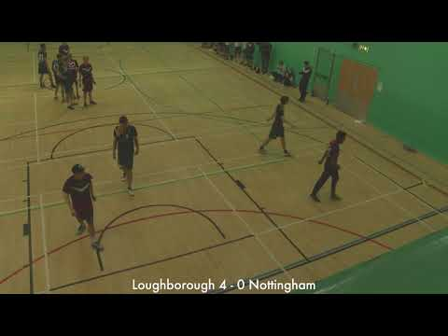
From the start and from about 3:20 in are examples of it being run but don’t include the up-line throw. Good endzone offence on show as well.

Slide 10
Side stack
A

Slide 11
*Video showing side stack working here*

Slide 12
Iso/Weave
3 players out the endzone running the weave, 2 in.
Dump/Up-line/Cross-pitch. Keep cutting through those 3 points.
Always be looking for the disc when cutting.
Progress up the pitch and then try to isolate someone in the endzone.
Stay structured. Take the overhead, cross-pitch shot if it’s on quickly. If it’s not a 90% shot then keep running the weave.
When you’re setting up as the Iso give yourself as much space on the break side as possible
https://www.ultiplays.com/shares/3mB20oXq0ESV4NrMOn9N
An offence that relies upon capable handlers, throws into space and sprinting well-timed cuts.

Slide 13

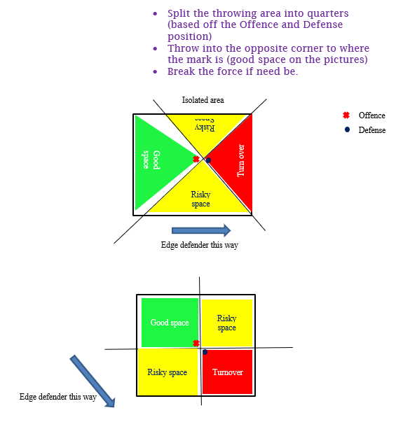
ISO guide:
Very clean example. Taking the easy shots. Hitting the overheads when needed and isolating the endzone player when needed

Slide 14
Against a zone
When the opposition sets up a defensive zone it is to break up your running set plays and force you to throw many smart passes.
As stated in the basics part you cannot run your planned offence (99% of the time) and your offence is now dictated by the defensive zone.
There is no ‘one-way’ to attack through a zone. But it may require a number of key elements. Handlers: playing with patience, throwing to the open person, throwing into space, give-go moves, and confident break throws. Cutters: finding space, occupying their defenders, calling for the disc, and recognising smart cuts.
Find holes/areas of weakness and exploit them quickly.
There’s no play to describe from the playbook here as every zone will be different and will shut down different looks.
Having a couple people tuned in on the sideline advising the players on the pitch what areas to exploit can be very useful but be careful having too-many-cooks.

Slide 15
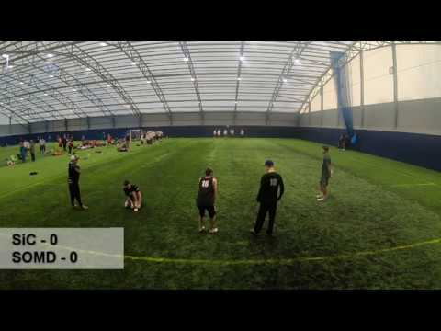
Just the first point from this match is included as a good example of using overheads and throwing to the open person against a 1-2-2 zone. The whole game was attacking a zonal defence so if you’re still unclear maybe watch through some more of the footage: https://www.youtube.com/watch?v=jeRTyOd2HeA

Slide 16
Endzone: “1 in”
Focuses on isolating one person in the endzone for a quick score.
4 out of the endzone set up as a ‘cross’. 1 middle, 1 break side, 1 open side, 1 super dump.
Trying to throw the easy score to the isolated player in the endzone, otherwise look at the breakside/ openside as resets or to go in and score themselves.
Use the super-dump to restart the offence.
If the play is in flow/active then the shot should be cutter initiated. If the play starts from a turnover the shot should be handler initiated.
Teams may try and clamp on the endzone player and leave a player outfield that is poached.
https://www.ultiplays.com/shares/Ve7wbgryV0Ul3N4VMD3D

Slide 17
Used the same clip that was in earlier. It’s a very simple premise for an endzone. Throw to the open-side of the isolated player.

Slide 18
Endzone: “2 in”
So this is a type of endzone set that will normally see use against a team that is running a wall-defence when they’re defending their endzone.
Won’t be as effective against person-defence as clamping 2 people in the endzone is much easier.
2 in the endzone focus on working together, exploiting small holes in the wall, unselfish cutting to create space for your partner and using the whole width/depth of the endzone.
3 out of the endzone focus on swinging the disc close to the endzone, looking to score and then swinging back. Use the fact that you have an extra person to make the resets easy. Consider sneaking in the endzone when the disc is swung to the opposite side for an overhead shot
As playing against a zone, patience and smart, confident throw choices are key here.
https://www.ultiplays.com/shares/8gqnNy97KQsreD95rqyg

Slide 19

Takes some time. But when the offence puts two people in the endzone and attack the front and back at the same time it is an easy score.

Slide 20
Defence

Slide 21
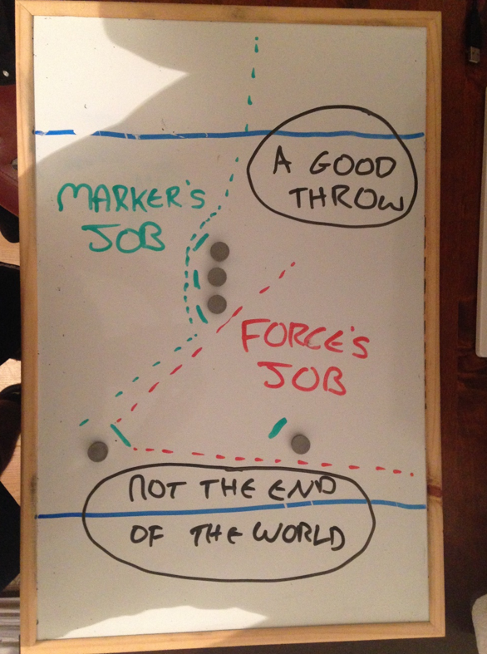
Person
Person defence indoors requires a lot of heads up awareness and agility.
You want to stay as close to your person as possible and always looking out for the more common overhead shots to the break-side.
A lot of teams like to force backhand indoors to make the more overhead (scoober) the break rather than the hammer.
‘Force middle’ is used as well. This requires more switching downfield as the idea is to always force the disc through the middle of the pitch, preventing the up-lines. This should not be confused with a force-middle zone.
Going to a clamp setup in the endzone from person defence is very common.

Slide 22
Endzone Clamp
‘Clamping’ the dangerous person in the endzone on either side to prevent easy break-side shots.
2 players either side of the isolated endzone player(s) and communicating to cover half of the endzone.
This can leave a player out of the endzone poached so the 3 outfield defenders need to work together to switch.
Definitely release the clamp if there is no-one to mark in the endzone and consider releasing the clamp if the disc gets swung back far enough that the endzone shot is less likely.
https://www.ultiplays.com/shares/m65yoXYM8vTJ1OJyOo1m

Slide 23

Some nice clamping by the sussex team here to prevent some shots that might have gone up if there wasn’t a player on either side

Slide 24
FM Zone
Basic 2-2-1 indoor zone. 2 chase/cup, 2 mids, 1 deep. This is flexible though and the shape off the zone will change.
The idea is to make the offence throw a lot of passes, potentially try some low-% overheads and stop their running offensive systems.
Chase are active at the front, One marking the handler (forcing middle), one poaching slightly in the lane.
2 mids take up the middle of the pitch covering overheads into the middle and trying to dissuade passes up the pitch by marking people in their areas.
The deep communicates with the mids to cover all downfield players. Ensuring that all offensive players are marked out at a time.
Keep eyes on the disc at all times
Use switches to cover give-go moves
Slow down the offense, make them throw lots, use when ahead a couple breaks
https://www.ultiplays.com/shares/9gZQPJB8XYsvNWQ80yRR

Slide 25
Zone footage here

Slide 26
Wall
The defensive endzone formation that most teams crumple into. The idea is to stop any goals and put little pressure on the offensive team.
Can be played 3-2 or 4-1. A wall of players and then 1 or 2 players outside putting pressure on the handlers.
The chase is to force normally until near the wall and then try to force into the wall.
Communicate in the wall, be patient, work together to cover as much of the endzone as you can.
Try not to get mismatched and be aware for people trying to get little dishy passes and jump in the endzone.
Disband the wall carefully back to a zone if the offence swings the disc far back enough.
https://www.ultiplays.com/shares/YeX3xp4Pjws6kMZmv491

Slide 27

Good example of 3-2 wall. Hassling the handlers and forcing a risky shot that ends in a turn. The fact the offence only had one person in the endzone may have been a contributing factor to the turn

Slide 28
NOTABLE RULES

Slide 29
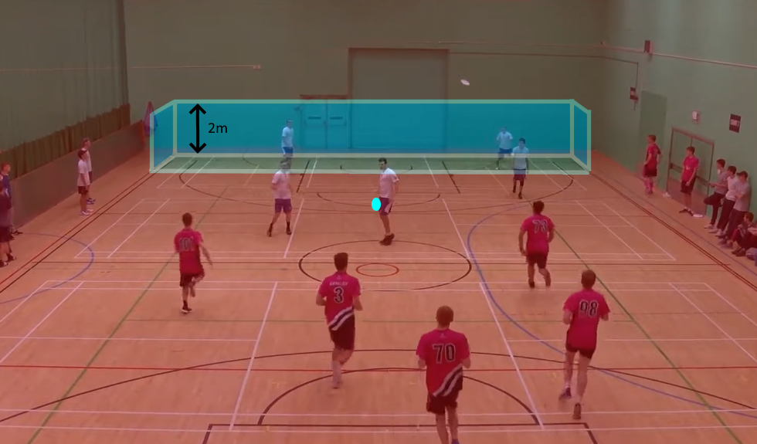
Brick rules
You can brick the disc (take the disc to the brick point ⅓ of the way up the pitch, light blue oval) if the discs first point of contact is
Outside the endzone
Over 2m out the back of the endzone
If the disc passes through the imaginary 2m high box (blue) around the endzone it cannot be bricked and has to be taken where it went out.
TAKE NOTE: “If a ‘valid pull’ initially contacts the playing field and never becomes out-of-bounds, the thrower must establish the pivot where the disc stops, even if that point is in their defending end zone”. I.e if you attempt to catch the pull and accidentally knock it down and it rolls away you take it from where it ends up.

Slide 30
Dead disc/Live disc checks.
“10.1. Whenever play stops during a point for a foul, violation, contested turnover,specified turnover, contested goal,stoppage, discussion, or at the completion of a time-out, play must restart as quickly as possible with a check.”
Check occurs with nearest defender or ground if no defenders are nearby.
The disc does not need to be checked in after these times:
Contact call
Travel call that doesn’t stop the game
Establishing play after a player caught the disc in-bounds but momentum carried them out
Only a pivot point needs to be established.
If in doubt - read the rules:
https://www.ukultimate.com/system/files/UKU%20Rules%20of%20Indoor%20Ultimate%202021-24.docx.pdf

Slide 31
Endzone
On offence, only one part of the scorer needs to touch the ground in the endzone. This can be used to make the endzone ‘larger’ by catching a disc further out from the endzone and trailing a leg in-bounds.
This can lead to the strategy of straddling the endzone line and then raising the leg in the playing field.

